Slide 1
CS 297P Guest Presentation: Co-op / Job Search
Gerry Meenaghan
Co-op Coordinator, Computer Information Technology

Slide 2
Student Success Starts Here…
Where does it end for you?
What’s your definition of student success?

Slide 3
Networking
In 1 minute, how many local businesses / companies can you list that would hire someone with your skill set?
What would happen if we combined our lists?
Networking is talking to people.
Notes:
Do all of you know each other?
How many want to stay in this area?

Slide 4
Notes:
http://www.quintcareers.com/getting_jobs.html
http://blog.jobfully.com/2010/07/the-math-behind-the-networking-claim/
http://www.forbes.com/sites/susanadams/2011/06/07/networking-is-still-the-best-way-to-find-a-job-survey-says/ (This is not the BLS data so commonly referenced, but from a different source)

Slide 5
Informational Interviews
One of the best ways to gain knowledge about an area of work is to talk to people doing that work.
Targeted informational interviewing: gain info. about specific employers, not for a job (necessarily), but for information. The focus is on the person who may have the power to hire you.

Slide 6
Informational Interviews: How?
Find a company of interest.
Get a name.
Make contact.
Prepare.
Record.
Evaluate.
Follow up.
Notes:
Other thoughts:
Ask each person you interview for suggestions of others to interview
Stick to the agreed-upon time limit.
Take information with a grain of salt. Don’t settle for one or two interviews.
Allow your interview subject to go off script. Let them talk.
Don’t ignore your personal feelings or vibes.
Ask the interview subject if they have any advice or insight into the best way to qualify for a position.
Ask the interview subject if they have any colleagues in the industry to whom they would be willing to refer you.

Slide 7
Job Search Resources
www.siliconshire.org
Oregon Labor Market Information System (OLMIS)
Craigslist
Eugene Area Chamber of Commerce / Springfield Chamber of Commerce
USAJobs.gov
Register Guard IT Jobs / EugeneJobs.net
OregonLiveJobs.com
Dice.com / GitHub / TechCrunch / ITJobPro / StackOverflow
Indeed.com / SimplyHired.com / CareerBuilder.com

Slide 8
“Who you know” & “Who knows you”
Get a business card with (at least) your name, professional focus, e-mail address, and phone number
LinkedIn
LinkedIn Groups, Discussions, Jobs
Twitter
Tweet chats (#newwebfrontier , #allstartups #winchat)
Facebook
About.Me
Virtual business card
Insert in e-mail signature

Slide 9
Resumes
Objectives out / Skills summary in
Combine technical and soft skills
http://www.techrepublic.com/blog/10things/10-highly-valued-soft-skills-for-it-pros/3353?tag=nl.e101&s_cid=e101&ttag=e101
Online resumes and portfolios
http://www.ldb4.com
http://www.ldb4.com/programming/
…samples of code
As with any online content, make sure that it is polished and professional!

Slide 10
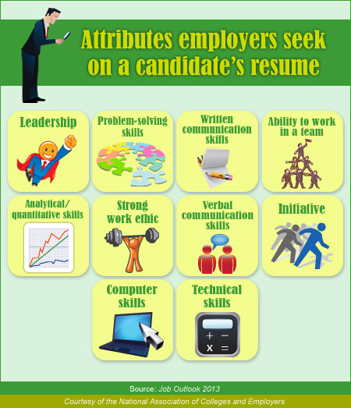

Slide 11
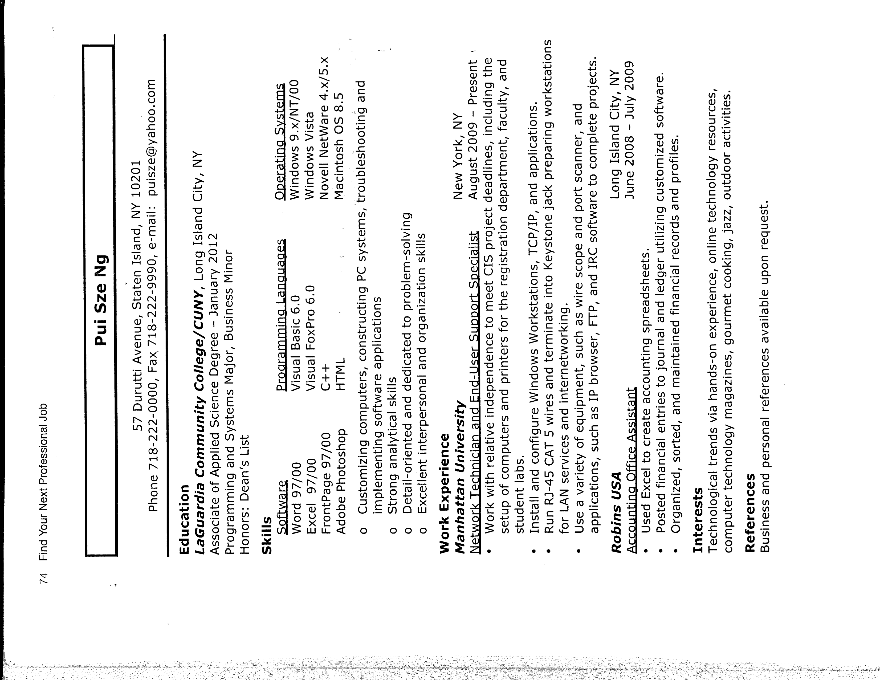

Slide 12
Co-op Rundown
Open entry, open exit – start anytime
3+ credits, 36 work hours per credit, 108 hours min.
10+ hours per week, 3+ hours per shift, ~11 week min.
Supervised, graded course with academic assignments.
Content of work aligns with academic curriculum and the world of work.
Develop your own or respond to co-op postings.
Receive approval from Co-op Coordinator.

Slide 13
Thank You!
Questions? Comments? Feedback?
Contact Info:
Gerry Meenaghan
meenaghang@lanecc.edu
541-463-5883
Building 19, Room 231A

