Slide 1
Beginning with the End in Mind
Guided Discussions Around Student Success and Career Satisfaction in PTA Education
Christina D Howard, MPT
PTA Program Coordinator
Lane Community College, Eugene, OR
howardc@lanecc.edu
A Faculty Development Workshop for New PT/PTA Faculty
Portland, OR 2015

Slide 2
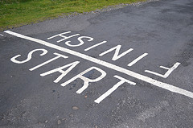
Reflecting on the Past
What have we learned about early career PTA educators?
A Faculty Development Workshop for New PT/PTA Faculty
Portland, OR 2015

Slide 3
Where shall we start?
Rank discussion topics based on your current faculty experience
Expand teaching and learning strategies
Mentor, advise and guide students with diverse skills, abilities, and backgrounds
Balance roles and responsibilities (teaching, advising, coordinating, assessing, scholarship, service, etc)
Align with accreditation and regional standards
Other topics?
A Faculty Development Workshop for New PT/PTA Faculty
Portland, OR 2015

Slide 4
Beginning with the End in Mind
Teaching and Learning
What skills and knowledge do students need?
Why do students need these skills?
How will I know that they have learned the skills?
How will students know that they have learned?
How do I “cover” everything that must be learned?
A Faculty Development Workshop for New PT/PTA Faculty
Portland, OR 2015

Slide 5
Integrating multiple learning outcomes
Case Study:
Hand washing and Infection Control
Notes:
Pass out lesson plan
Present copy of degree outcomes
Align with ILOs, PLOs, and CLOs

Slide 6
Beginning with the End in Mind
Student Success
What are “High Impact Practices” and,
Where do they fit in PTA Education?
How do these align with clinical and professional work?
How do we integrate practices and meet workplace expectations within a two-year degree?
A Faculty Development Workshop for New PT/PTA Faculty
Portland, OR 2015
Notes:
http://aacu.org/publications-research/periodicals/college-outcomes-work-life-and-citizenship-can-we-really-do-it-all

Slide 7
HIPs
Examples in PTA Education
Active and collaborative learning
Academic challenge
Student-faculty interaction
Support for learners
http://www.ccsse.org/docs/Engagement_Rising.pdf
A Faculty Development Workshop for New PT/PTA aclty
Portland, OR 2015
Notes:
What are you doing already, or, what was effective for you as a learner
Scaffolding challenges – examples?
Examples of remediation

Slide 8
Integrating high impact practices
Case Study:
Connecting to workplace readiness
A Faculty Development Workshop for New PT/PTA Faculty
Portland, OR 2015
Notes:
Rubric for group projects

Slide 9
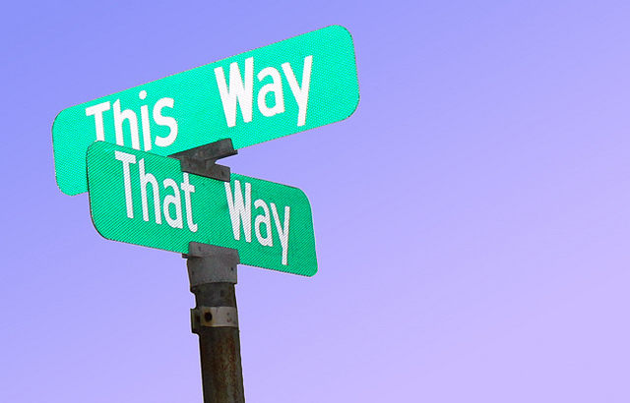
Integrating high impact practices
Corrective action planning
Academic
Clinical
A Faculty Development Workshop for New PT/PTA Faculty
Portland, OR 2015
Notes:
Samples from Beth

Slide 10
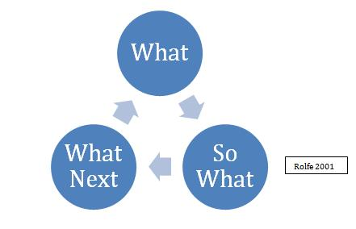
Personal Mission Statement
What are your guiding principles?
What does your “end” look like?
Have you allowed for agility, flexibility, and reflection?
A Faculty Development Workshop for New PT/PTA Faculty
Portland, OR 2015

Slide 11
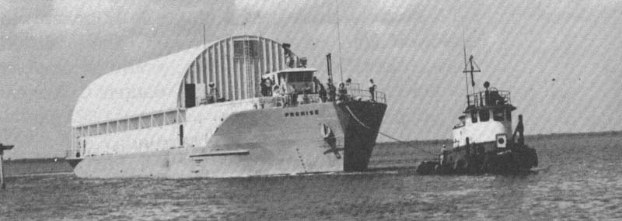
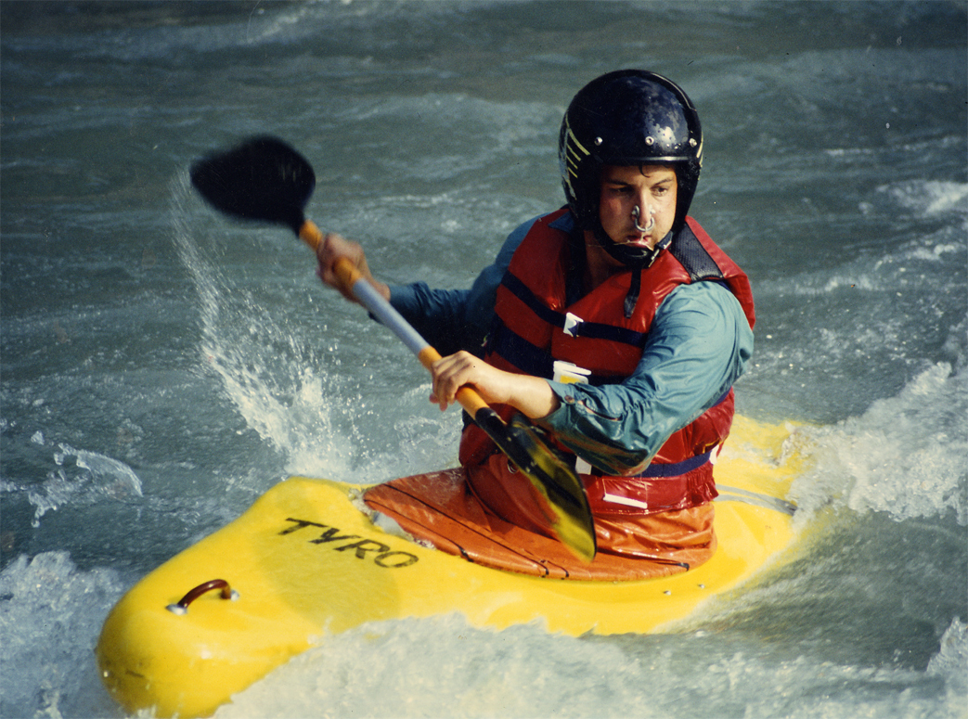
Career Success – Student-Centered Practice
Serve strategically
Meet for support
Champion improvement efforts
Promote discipline knowledge and expertise
Connect to mission
A Faculty Development Workshop for New PT/PTA Faculty
Portland, OR 2015
Notes:
By Jörg Helbig (own picture (Merops 22:43, 27 December 2005 (UTC))) [GFDL (http://www.gnu.org/copyleft/fdl.html) or CC-BY-SA-3.0 (http://creativecommons.org/licenses/by-sa/3.0/)], via Wikimedia Commons

